Slide 1
Final Project
Project : Flower shop management
Group : 01
Lecturer: Hồ Thị Thanh Tuyến

Slide 2

Group Members
Nguyễn đình việt hoàng – 522h0120
Huỳnh vũ minh hiếu – 522h0024
Ngô trung tiến – 522h0040
Hoàng văn minh – 522h0020

Slide 3
Contents
System Overview
Identify and analyze requirements
System requirements specification
System analysis and design

Slide 4
1. SYSTEM OVERVIEW

Slide 5
Introduction
- The flower shop management system is a system developed to manage the business operations in a flower shop. Currently, managing a flower shop involves various challenges, including selecting and purchasing flowers from suppliers, managing inventory, scheduling deliveries, and maintaining customer information.
- The flower shop management system aims to address these challenges by automating management processes, enhancing inventory management capabilities, managing customer information, and providing statistical reports to support business decision-making.

Slide 6

Agenda
Introduction
Building confidence
Engaging the audience
Visual aids
Final tips & takeaways

Slide 7
Objectives
Manage the process of flower information input and output, including selecting and purchasing flowers from suppliers, managing inventory, and monitoring stock levels.
Manage customer information, including storing personal information, purchase history, and customer preferences.
Create delivery schedules and manage customer orders.
Provide statistical reports on revenue, inventory, and business activities.
Integrate online ordering functionality to allow customers to place flower orders online and track order status.

Slide 8
Scope
The flower shop management system focuses on the following entities:
1. Customers
2. Flower shop staff:
Store managers
Sales staff
Inventory managers
Customer information managers
Delivery employees
3. Related parties:
Suppliers
Business partners

Slide 9

2. REQUIREMENTS IDENTIFICATION AND ANALYSIS
Interview
Analyze the current situation
System management process

Slide 10

3. SYSTEM REQUIREMENTS SPECIFICATION

Slide 11
Interview
Interview Plan Overview System: Flower Shop Management Prepared by: Nguyễn Đình Việt Hoàng Date 9/4/2024
Subjects | Requirements | Start dates | End dates
Product Management | + Understand the process of receiving, preserving, and arranging various types of flowers. + Know how to contact and order from flower suppliers. + Manage inventory and ensure a diverse product range for customers. | 8/4/2024 | 11/4/2024
Promotion Strategy | + Develop promotional programs (discounts, gifts) to attract and retain customers. + Update information and news about new flowers, special events. | 8/4/2024 | 11/4/2024
Customer Management | + Store and analyze customer information to improve service. + Accumulate points and upgrade membership cards based on purchase levels. | 8/4/2024 | 11/4/2024
Statistical Reports | + Conduct sales reports, accompanying services. + Evaluate business performance over specific periods. | 12/4/2024 | 14/4/2024
System and Software | + Assess and upgrade machinery and software to optimize workflows. + Perform regular maintenance and repair equipment when necessary. | 12/4/2024 | 14/4/2024

Slide 12
Current state of organization:
Board of Directors
Product Management Department
Store Space Management Department
Hồng Loan Flower Shop
Staff Management Department
Sales Management Department
Marketing & Advertising Department
Accounting Department
Technical & Maintenance Department

Slide 13
System management steps
Search Flowers
Purchase Flowers
Flower Inventory Management
Sales and customer service
Advertising and marketing
Flower Design and arrangement
Financial management
Maintenance and upgrades

Slide 14
4. SYSTEM ANALYSIS AND DESIGN

Slide 15
FUNCTIONAL MODELING

Slide 16
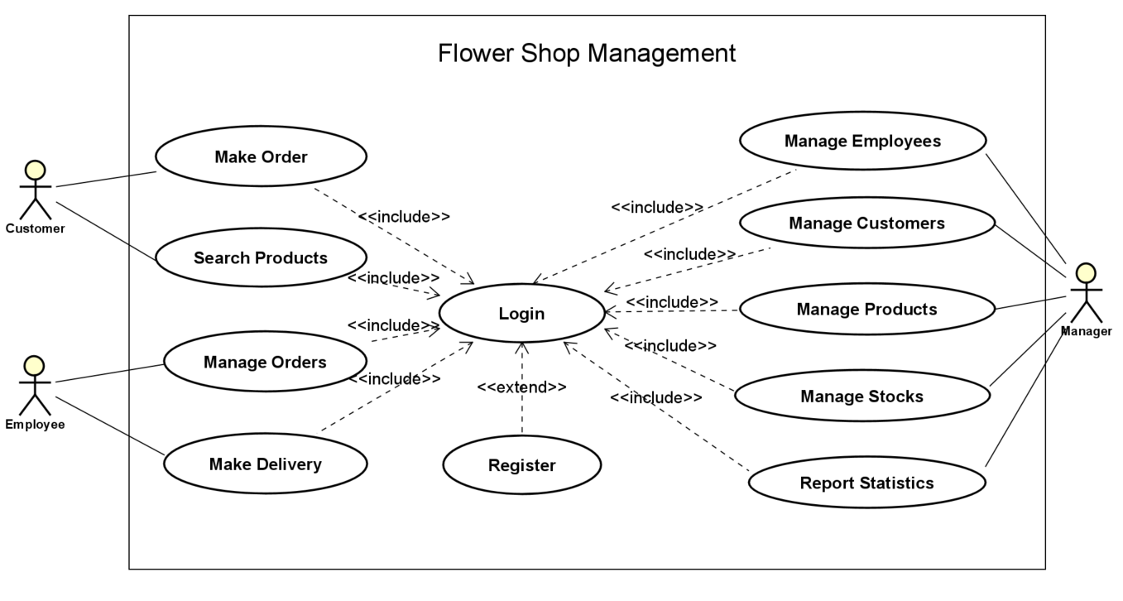
Use Case Diagram

Slide 17
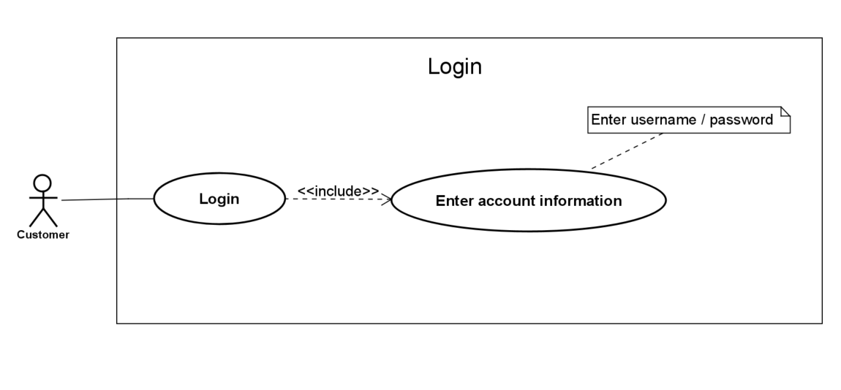
Use Case Login #01

Slide 18
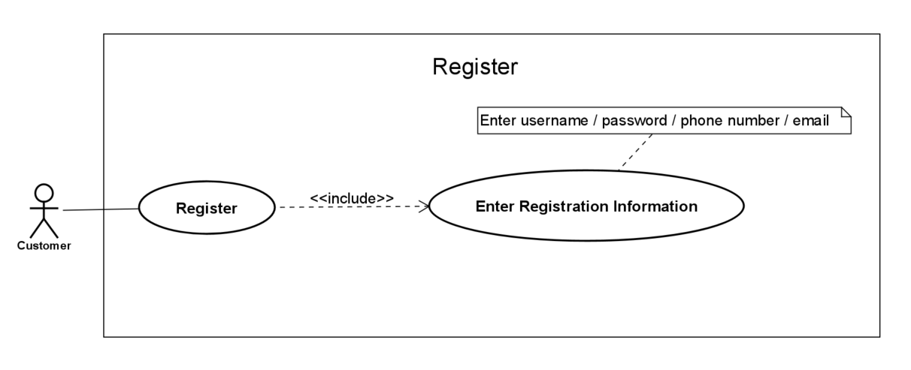
Use Case Register #02

Slide 19
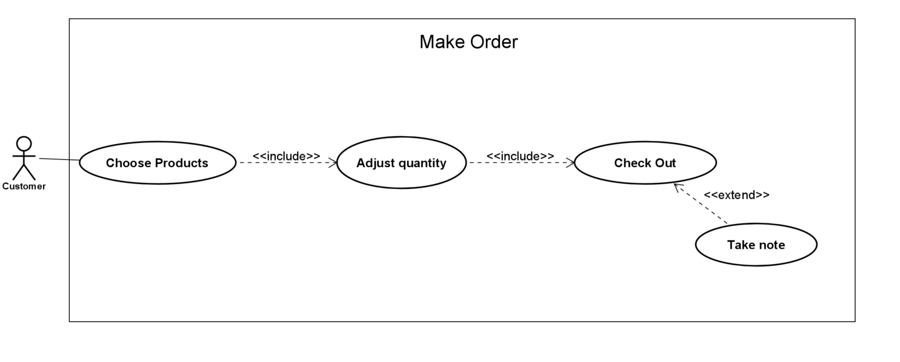
Use Case Make Order #03

Slide 20
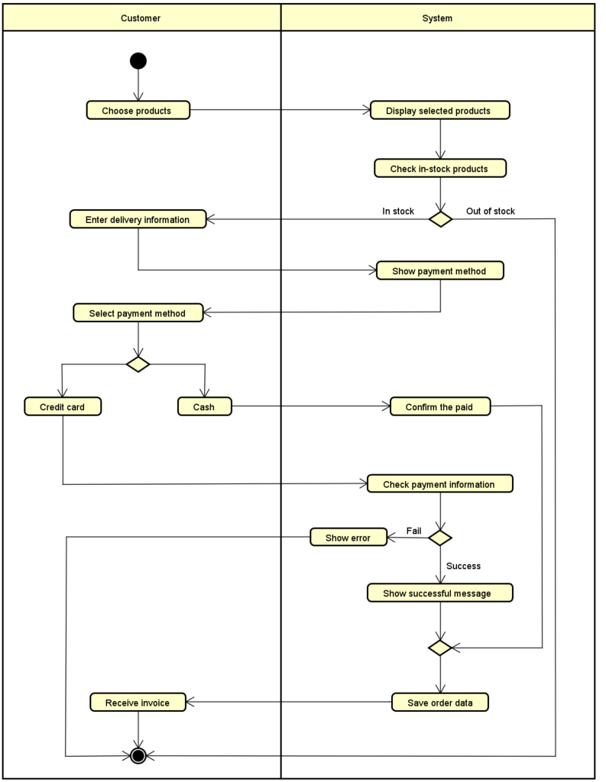
Activity Make Order

Slide 21
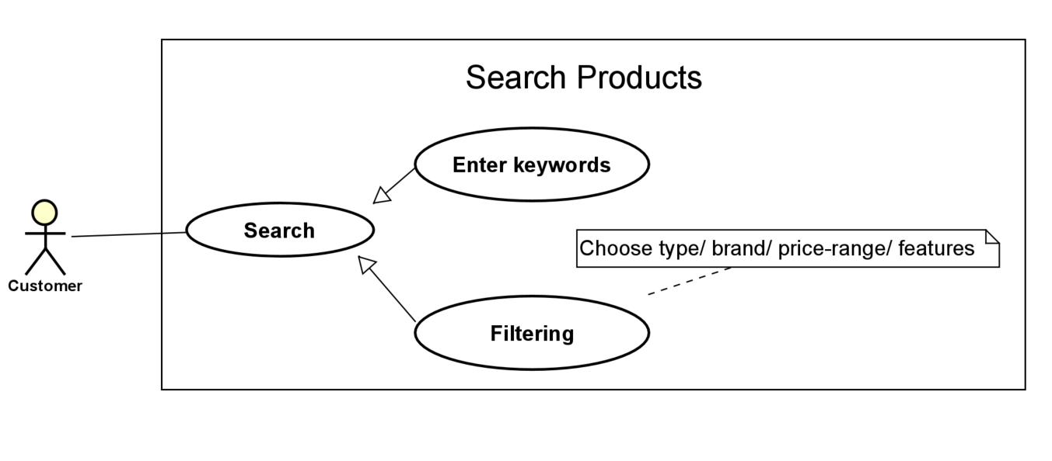
Use Case Search Products #04

Slide 22
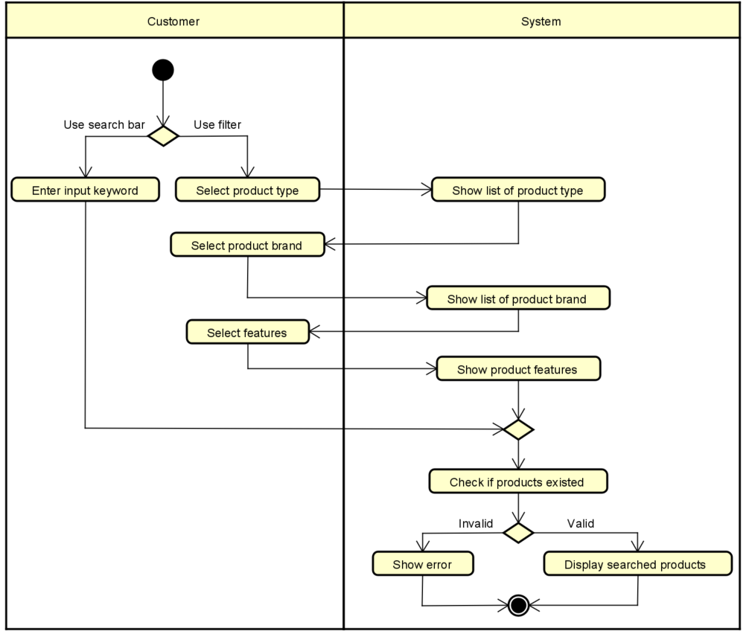
Activity Search Products

Slide 23
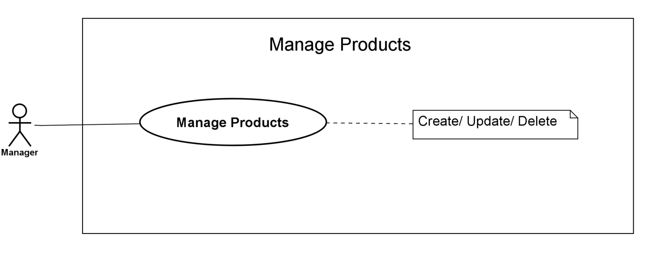
Use Case Manage Products #04

Slide 24
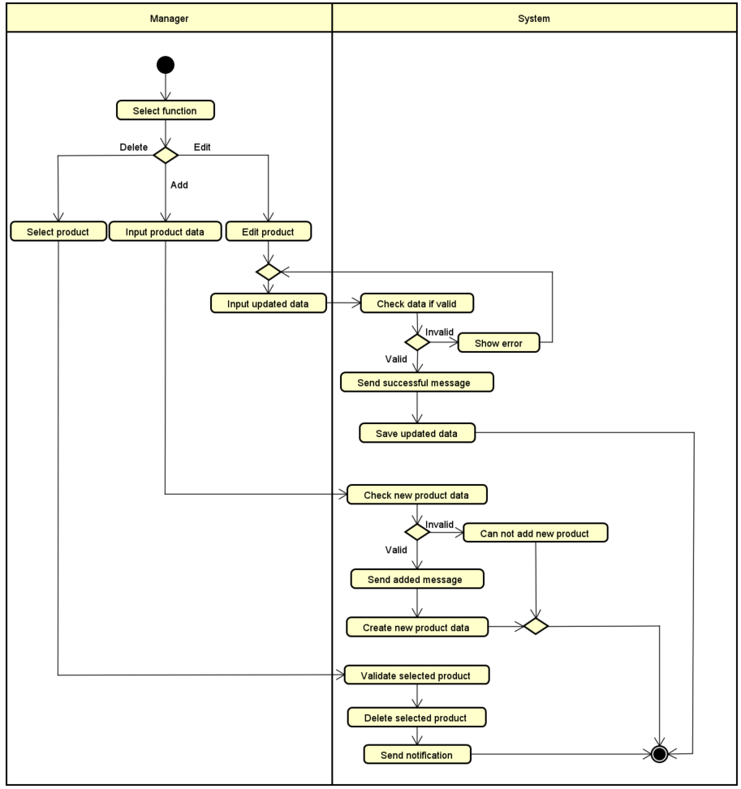
Activity Manage Products

Slide 25
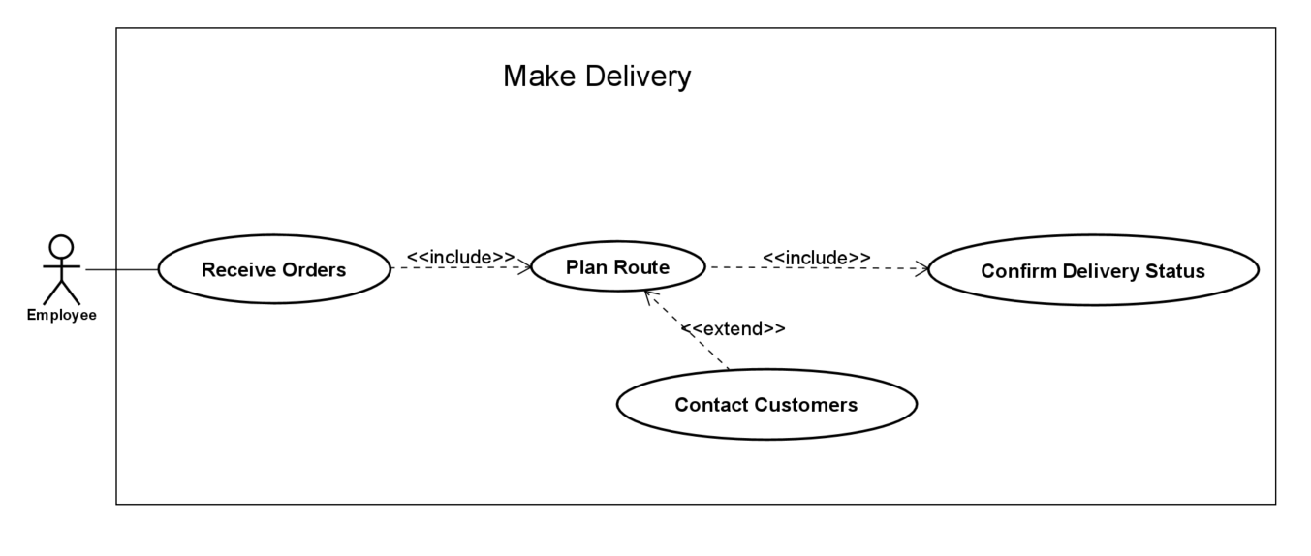
Use Case Make Delivery #05

Slide 26
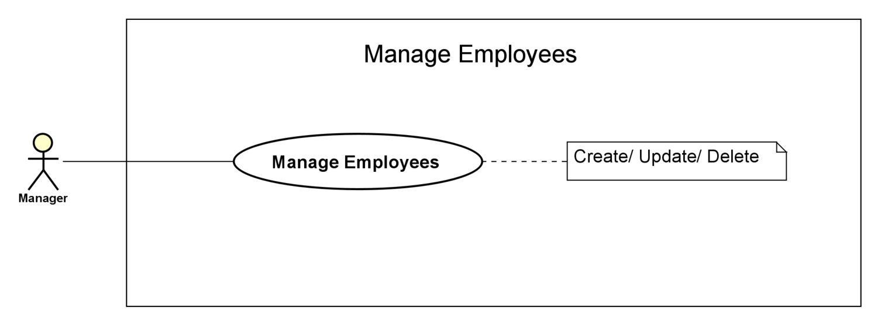
Use Case Manage Employees #06

Slide 27
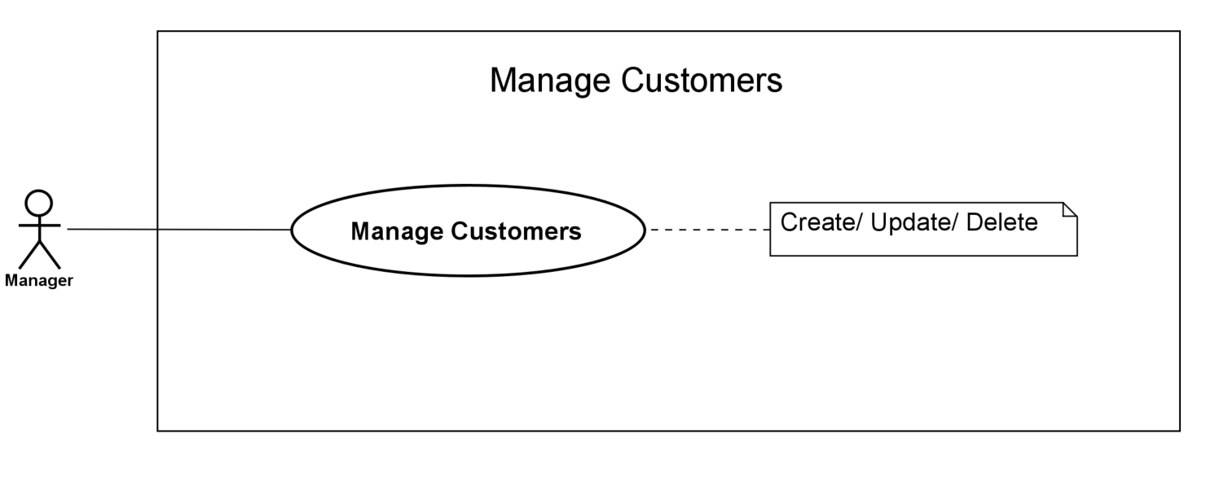
Use Case Manage Customers #07

Slide 28
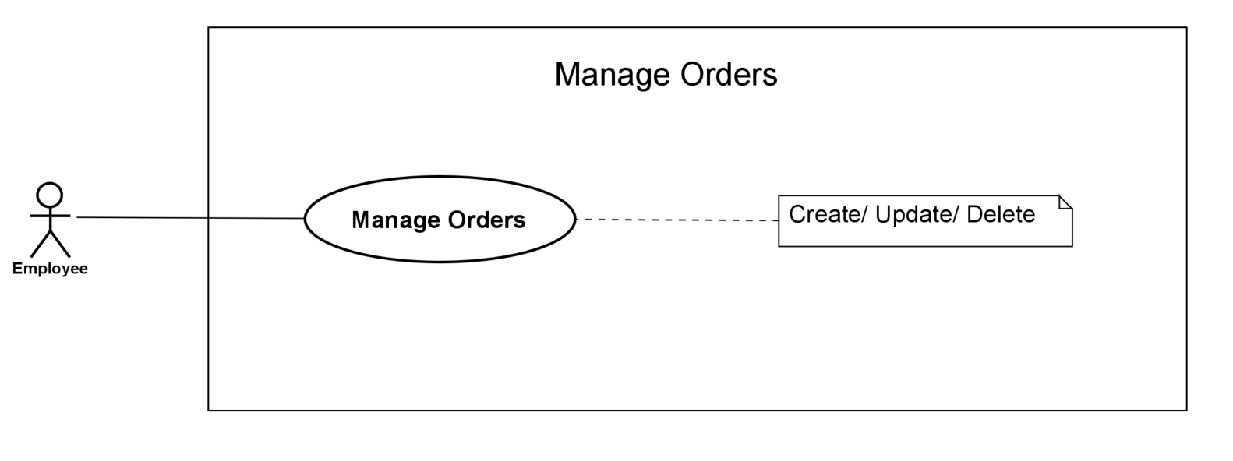
Use Case Manage Orders #08

Slide 29
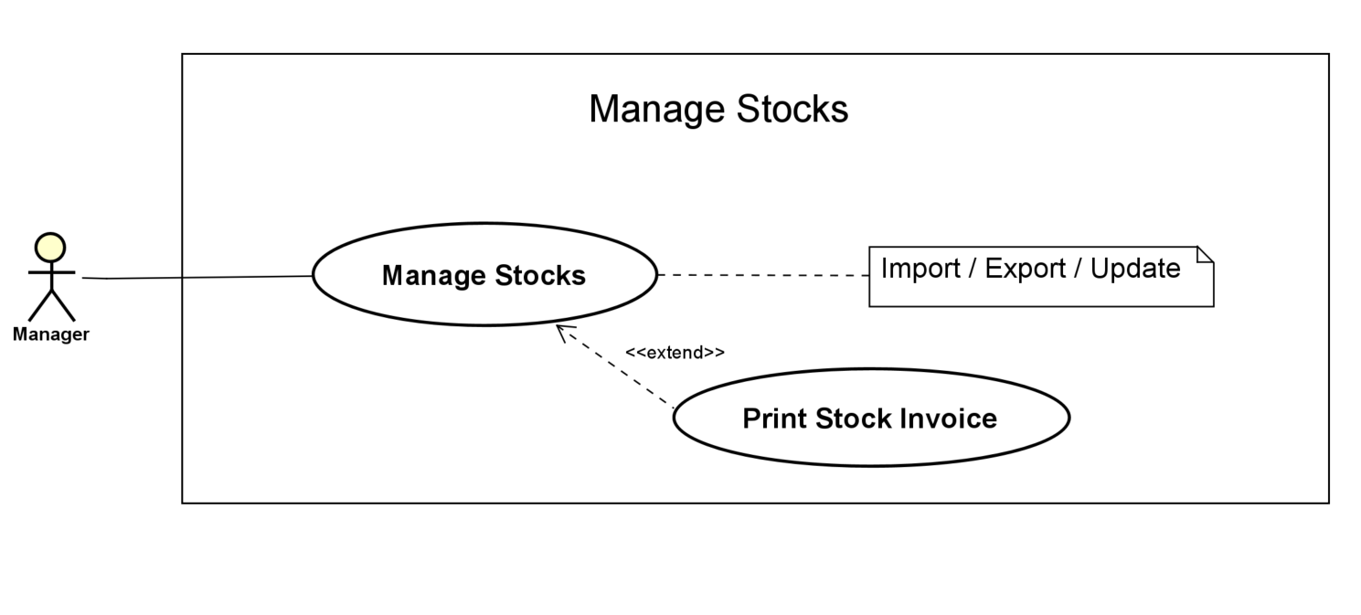
Use Case Manage Stocks #09

Slide 30
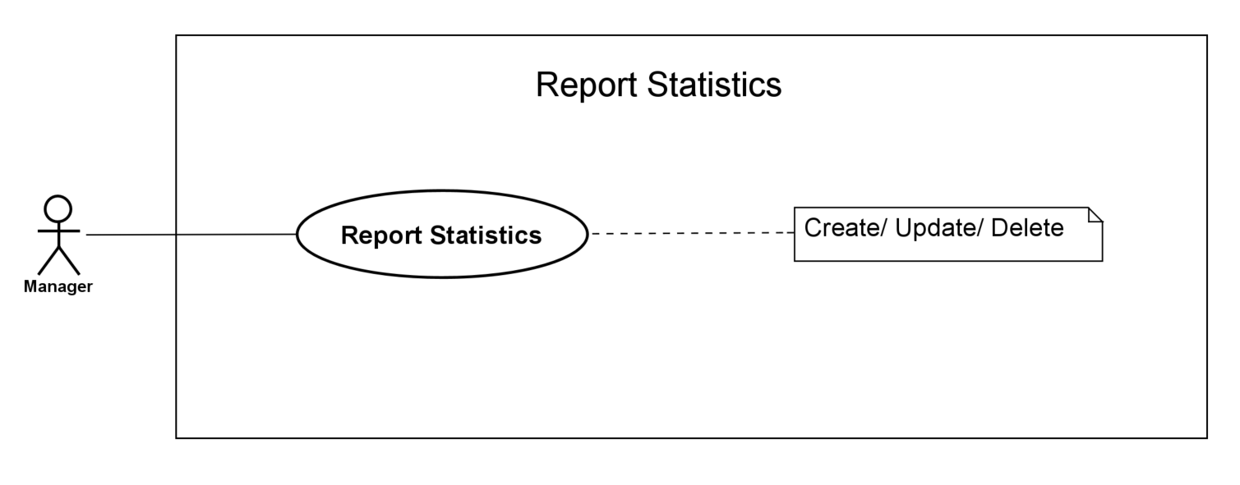
Use Case Report Statistics #10

Slide 31
BEHAVIORAL MODELING

Slide 32
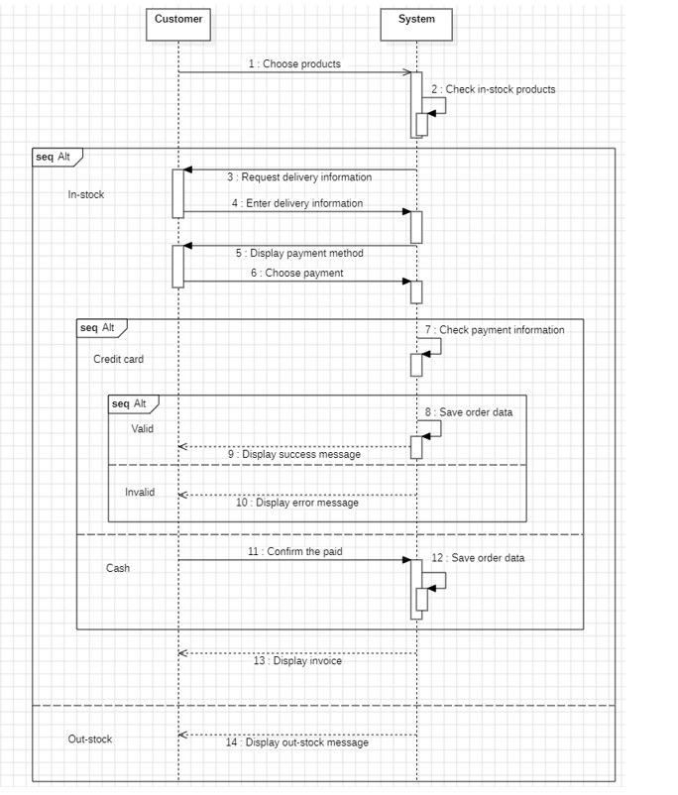
Sequence Make Order

Slide 33
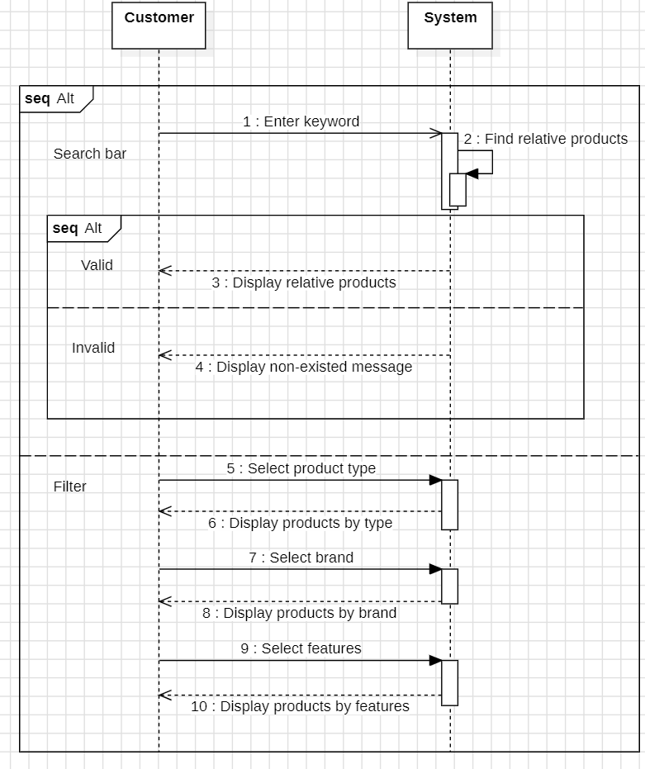
Sequence Search Products

Slide 34
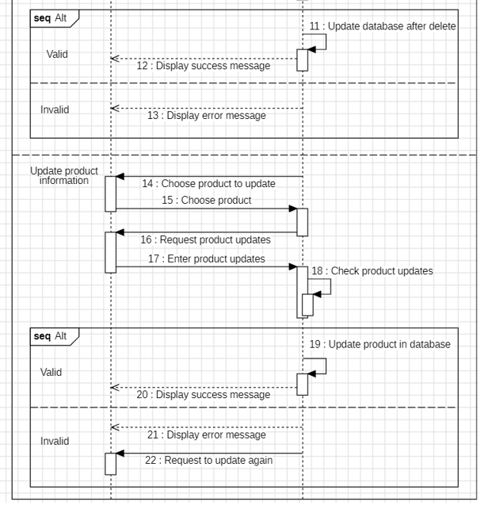
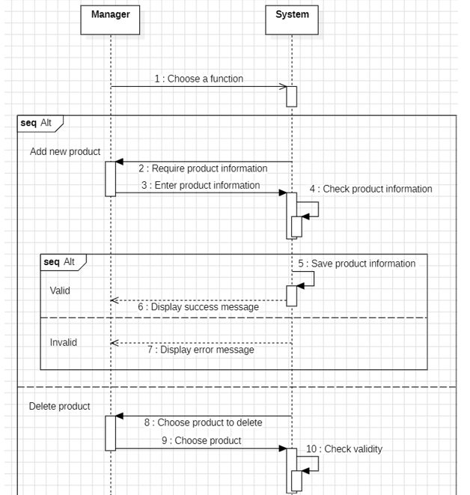
Sequence Manage Products

Slide 35
STRUCTURAL MODELING

Slide 36
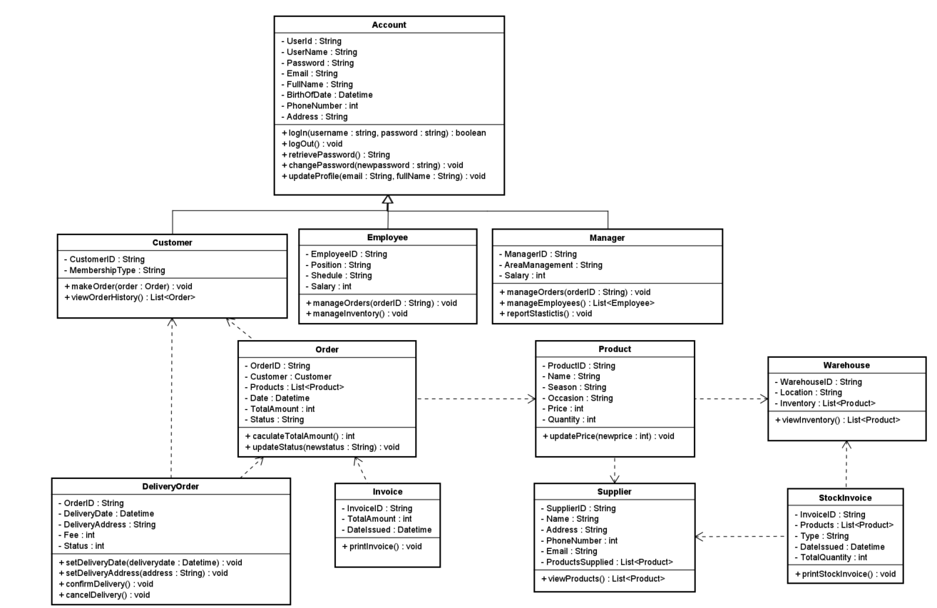

Slide 37
DATA MODELING

Slide 38
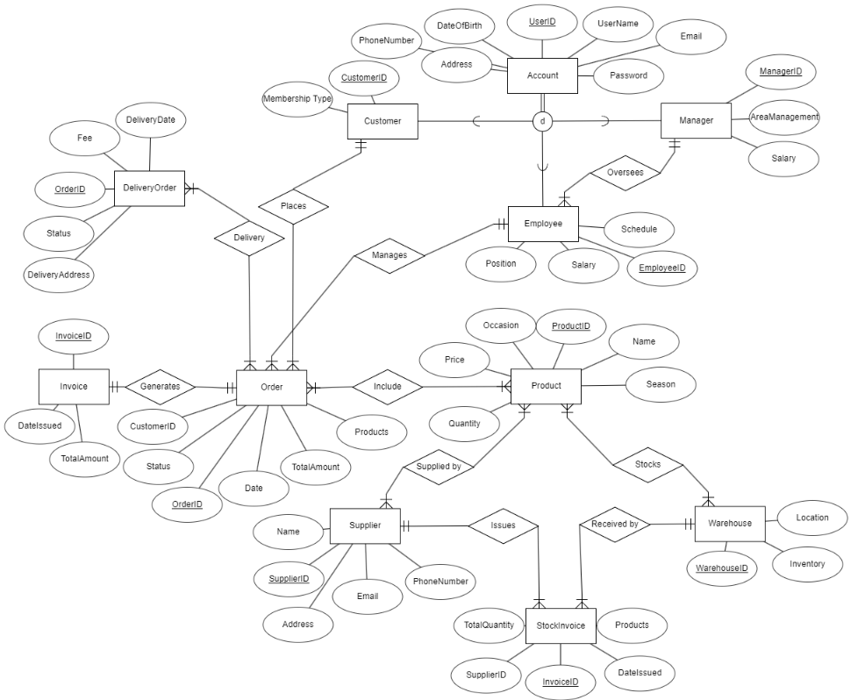

Slide 39
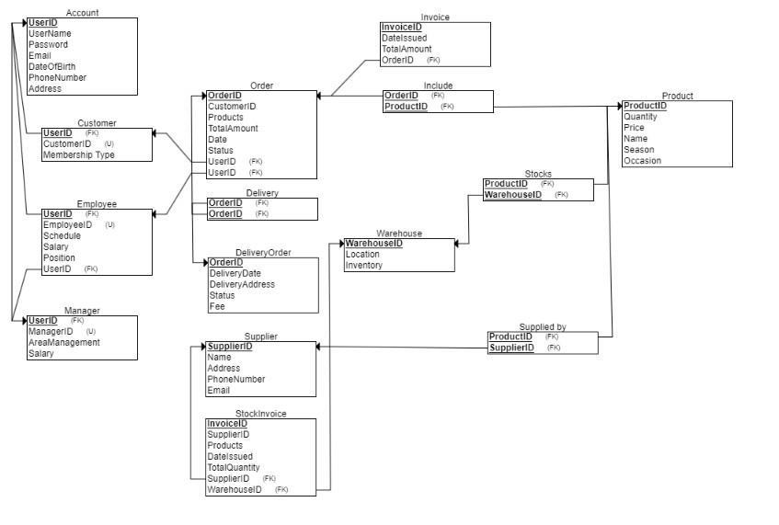

Slide 40
DESIGN

Slide 41
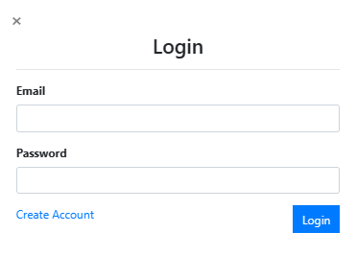
Login

Slide 42
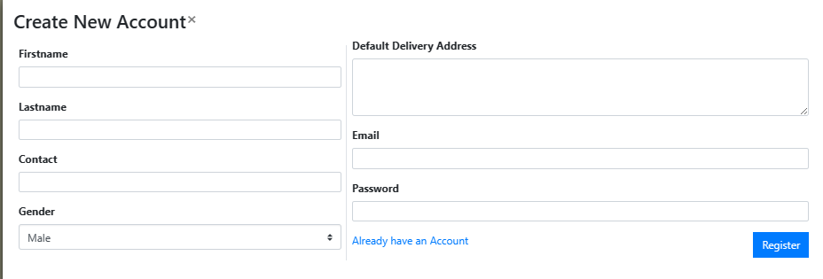
Register

Slide 43
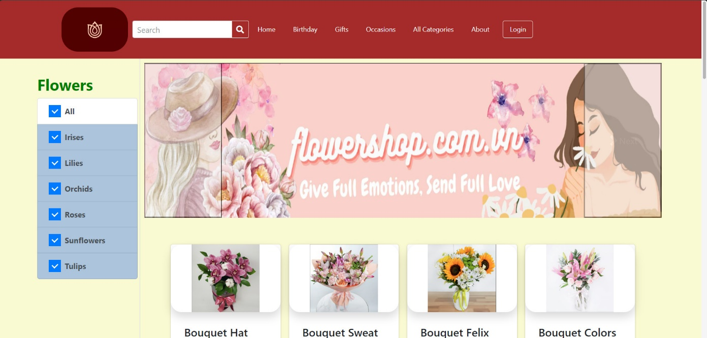
Home page

Slide 44
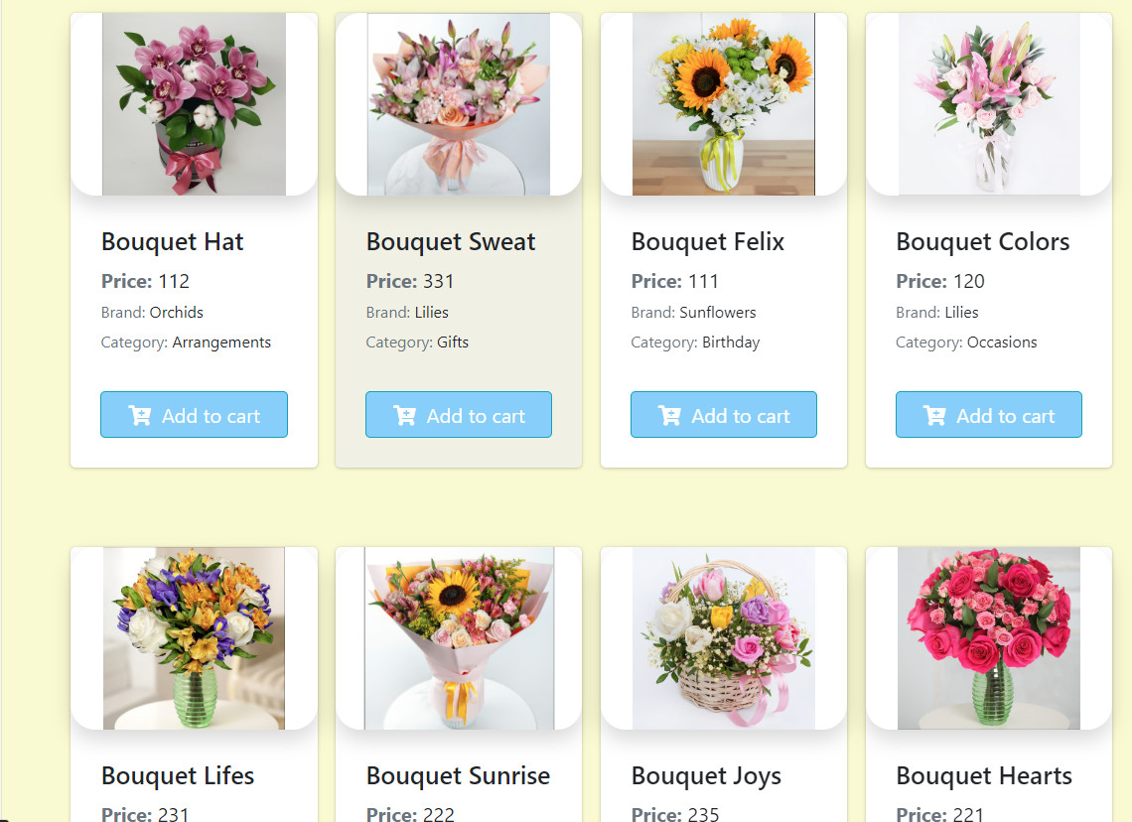
View products

Slide 45
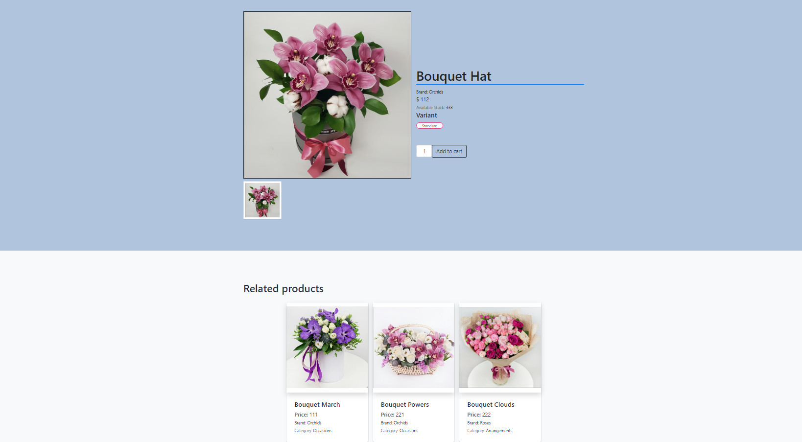
Product details

Slide 46
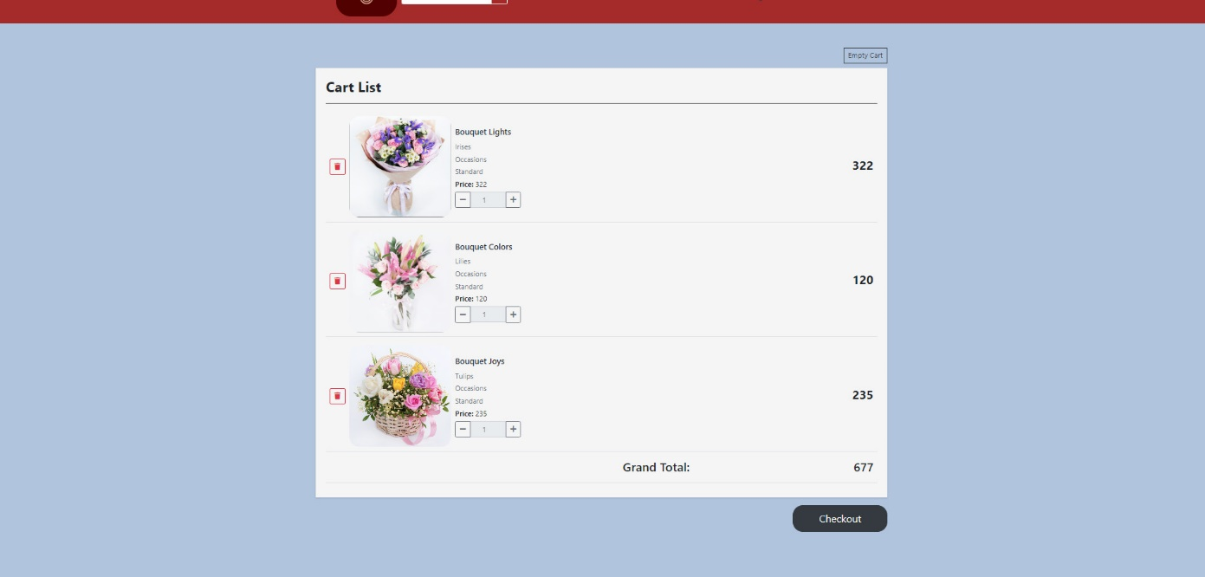
Manage Cart

Slide 47
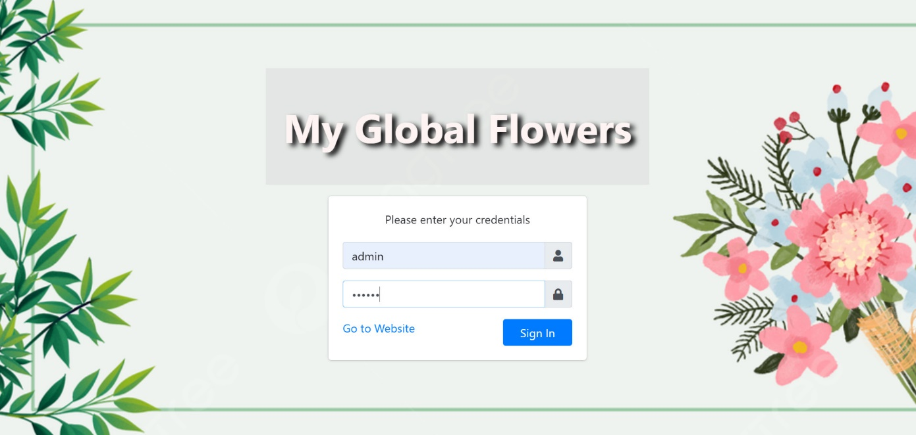
Admin login

Slide 48
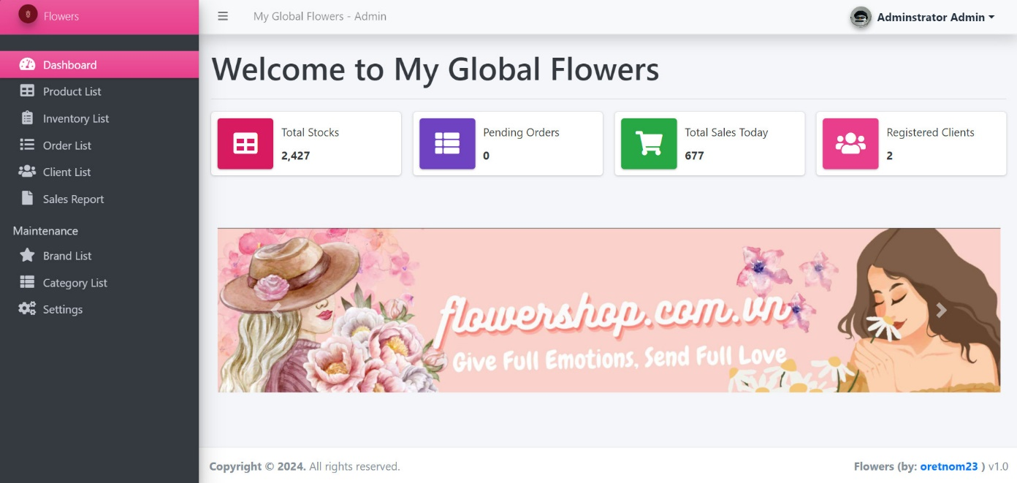
Admin home page

Slide 49
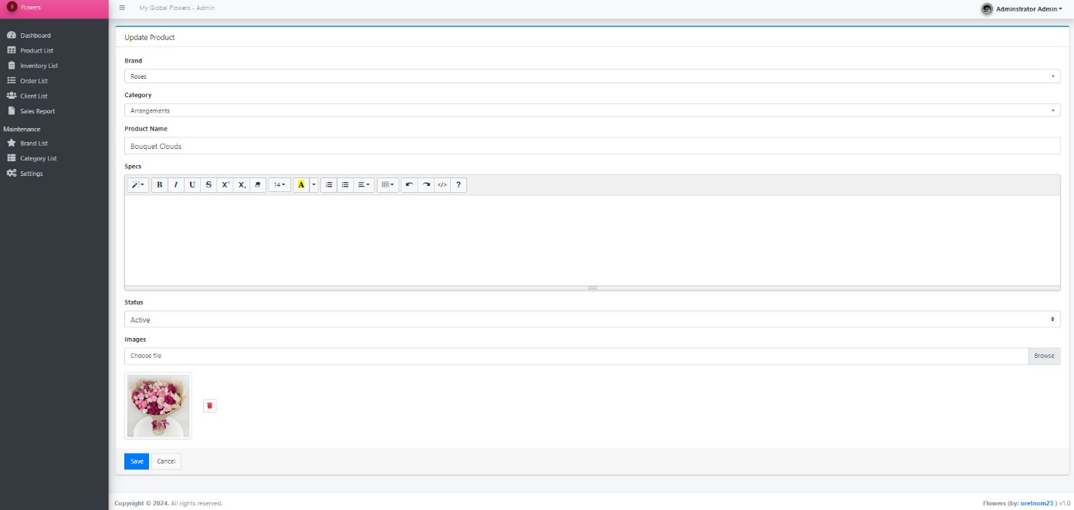
Manage products

Slide 50
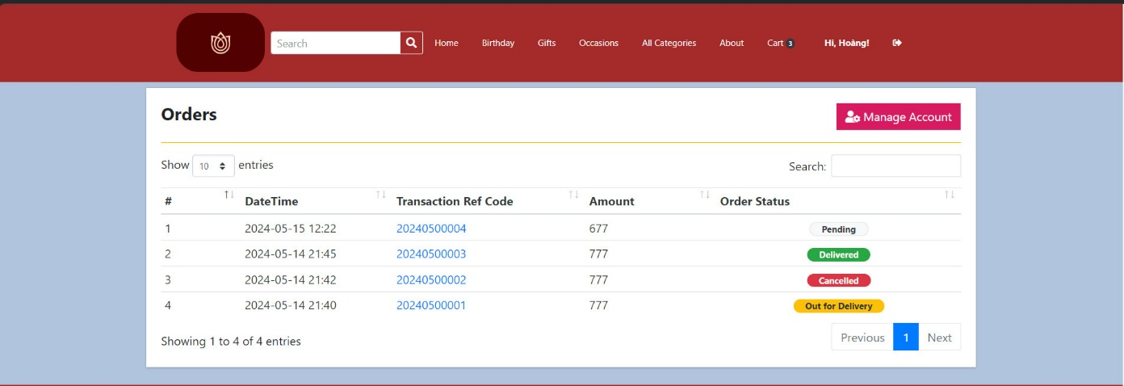
Manage orders

Slide 51
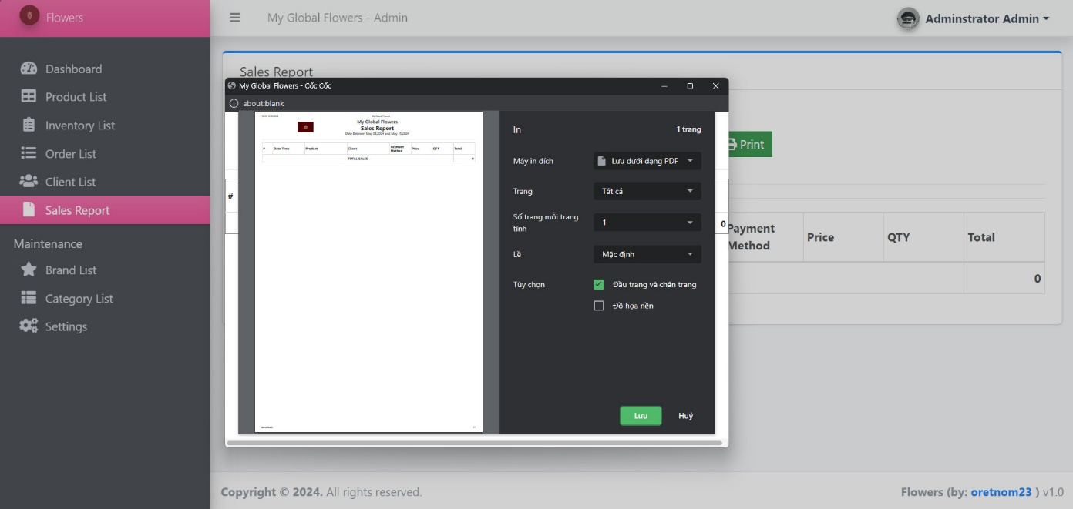
Sales Report

Slide 52
Advantages : - Plenty of resources are available for reference, and team members are proactive in searching for relevant documents to support the report. - Lecturers deliver their teachings in a clear and understandable manner, actively contributing ideas for the group's tasks, and pointing out any mistakes the group may make. Difficulties: - Due to lack of experience in group work, members occasionally struggle to grasp each other's ideas. - The subject matter is extensive and intricate, demanding each member to thoroughly comprehend related topics. - There's a lack of well-structured time allocation and scheduling between subjects. Time is wasted rectifying syntax errors stemming from insufficient consultation of the slides. Lessons: - Prioritize Communication Skills: help improve understanding and collaboration - Emphasize Comprehensive Understanding: Providing resources and support to help members grasp related topics can enhance overall performance. - Implement Effective Time Management: prevent inefficiencies and maximize productivity.

Slide 53
Thank you!
Have a good life!

